Slide 1
Text to Tech
Connor Moriarty

Slide 2
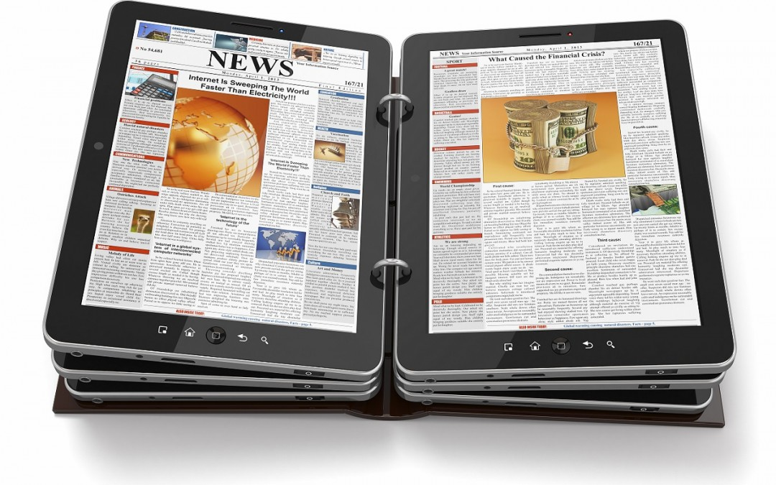
Print
Digital

Slide 5
Photography

Slide 6
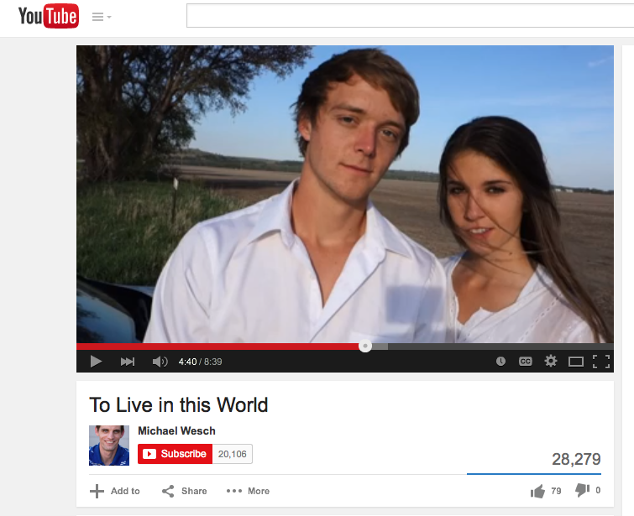

Slide 7
Project 3
Prints to Pixels
https://www.youtube.com/watch?v=B-qmVz_EHHY&spfreload=10

Slide 8
Rhetorical Elements
Both contrast and similarities for emphasis
All quotes
Happy music
Film roll sound effect
100% authentic video

