Slide 1
Eating Disorders at Miami University

Slide 2
What is an eating disorder?
Anorexia Nervosa
Binge Eating
Bulimia

Slide 3

MiamiUEatingDisorders.wordpress.com

Slide 4
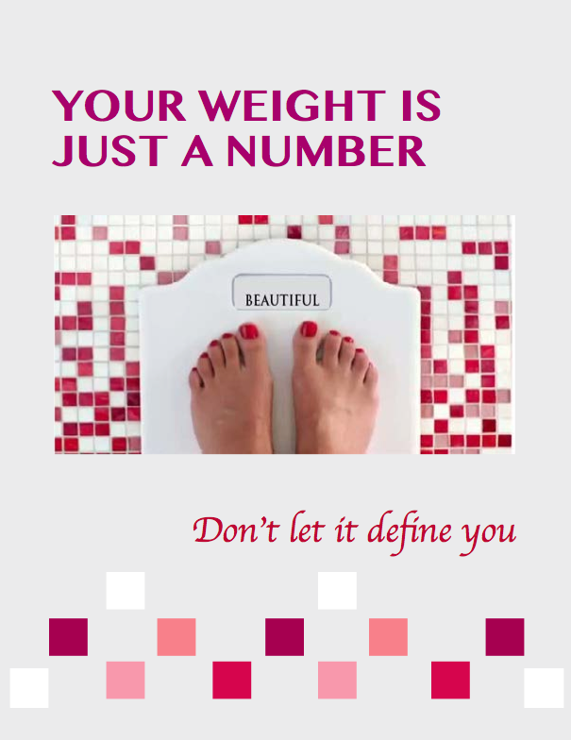

Slide 5
Food is Not the Enemy, Self Hate is!
You are enough
Your value is not measured in pounds
Sexy is not a size

